Slide 1
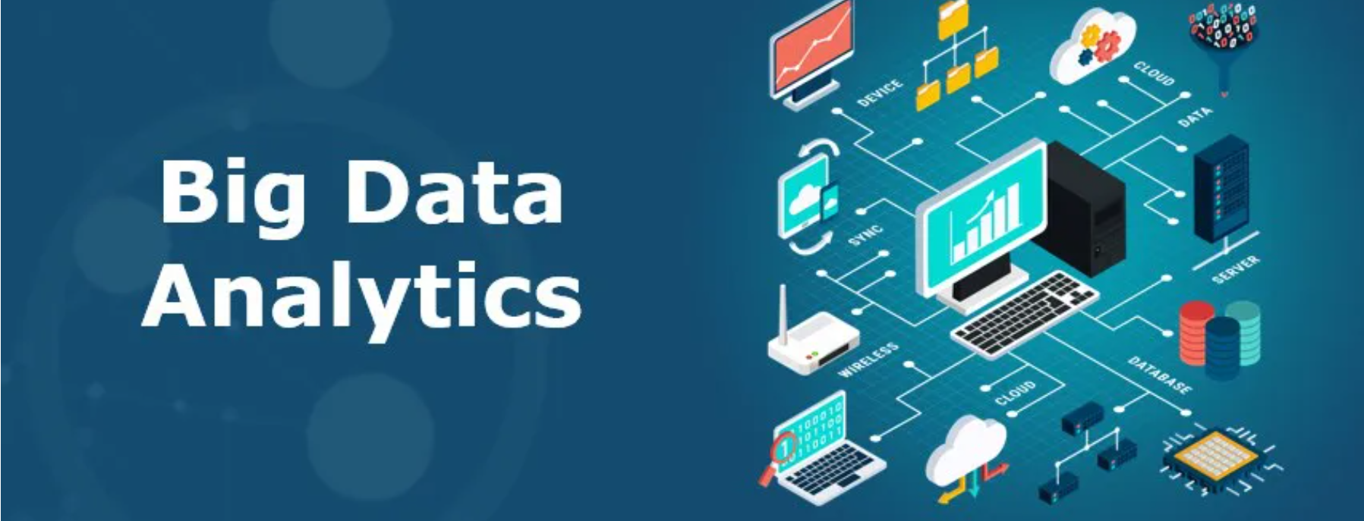
Human Mortality
Student Name:
Bhanusree Penukonda
Suhail Arfaath
Sri Hari Krishna Perla
Vishal Kumar

Slide 2
Project Purpose
When the issues are identified, they can be minimized
Digging the overlooked issues could highlight key elements that can possibly affect the mortality rate
Spreading awareness
Contributing to the good cause
Responsibility as a human being to care for another human being

Slide 3
Why we choose Apache Spark for this project
Performance
Ease of Use
Data Processing
Security
Fault Tolerance
Multilingual

Slide 4
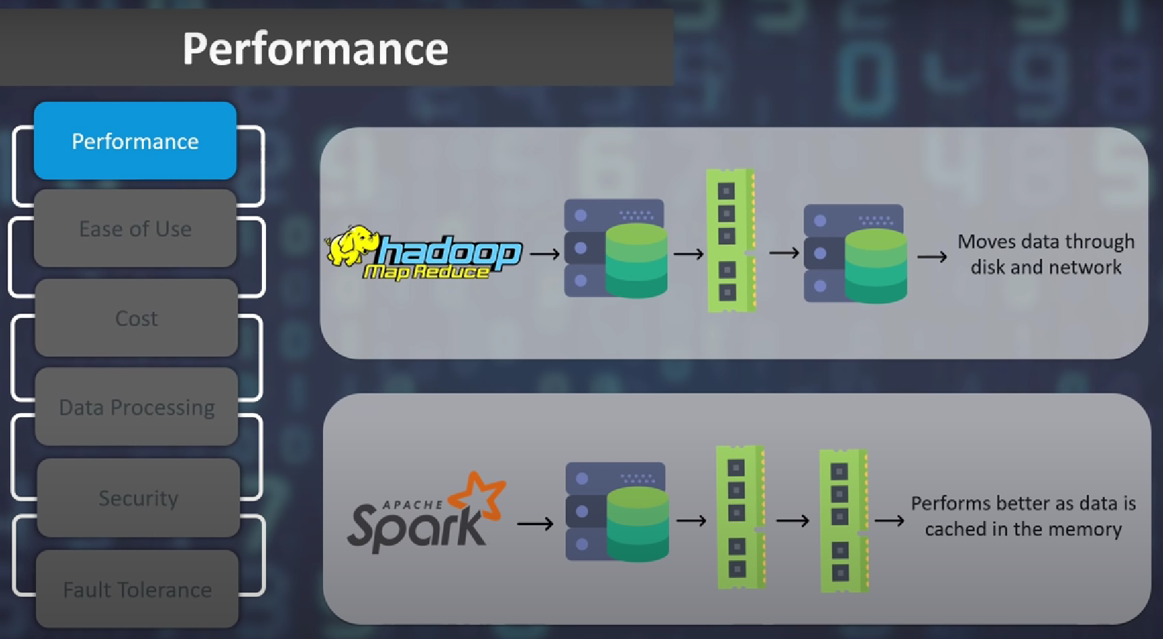

Slide 5
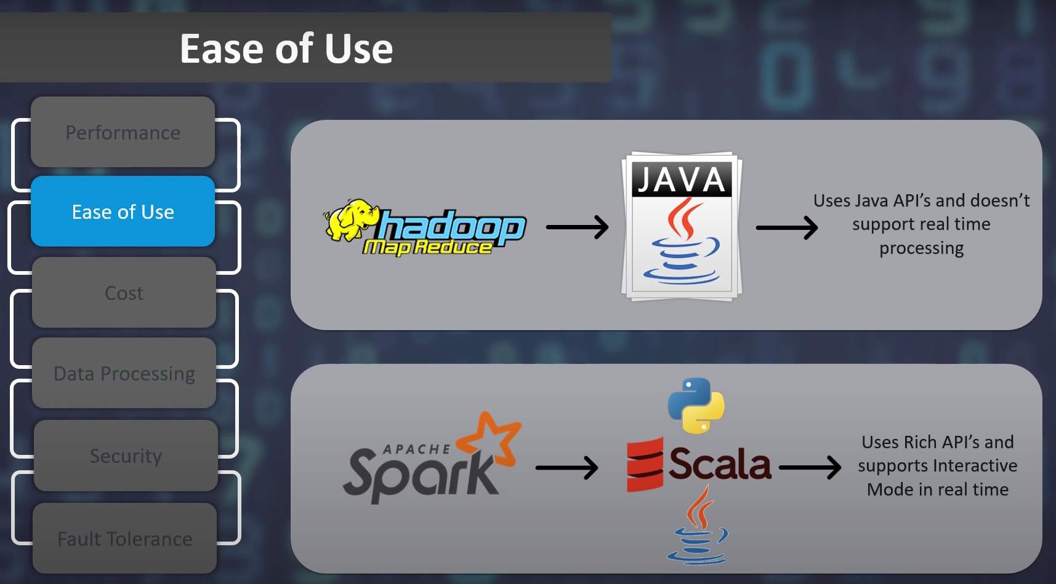

Slide 6
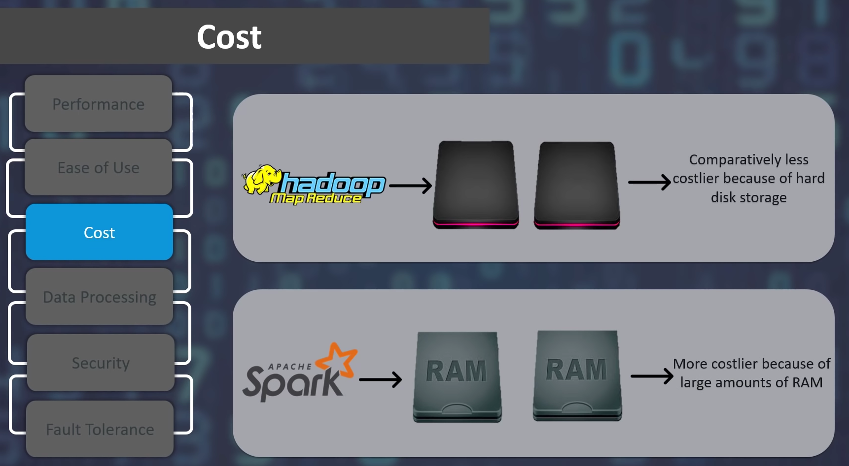

Slide 7
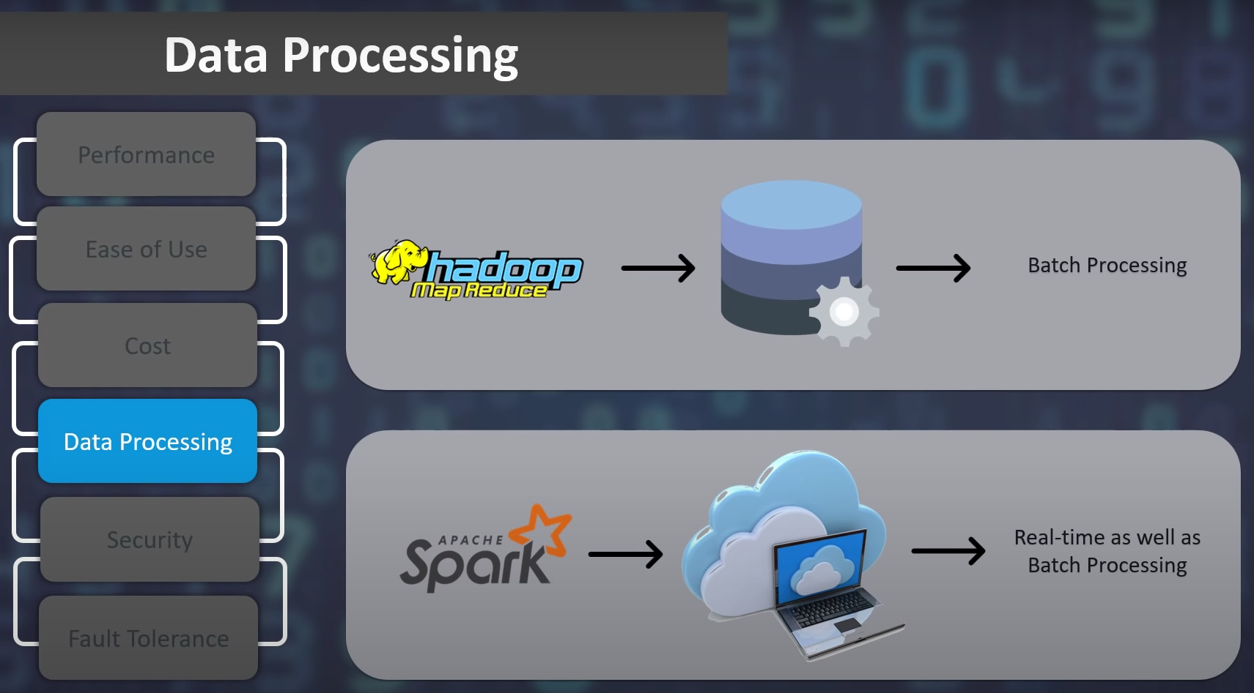

Slide 8
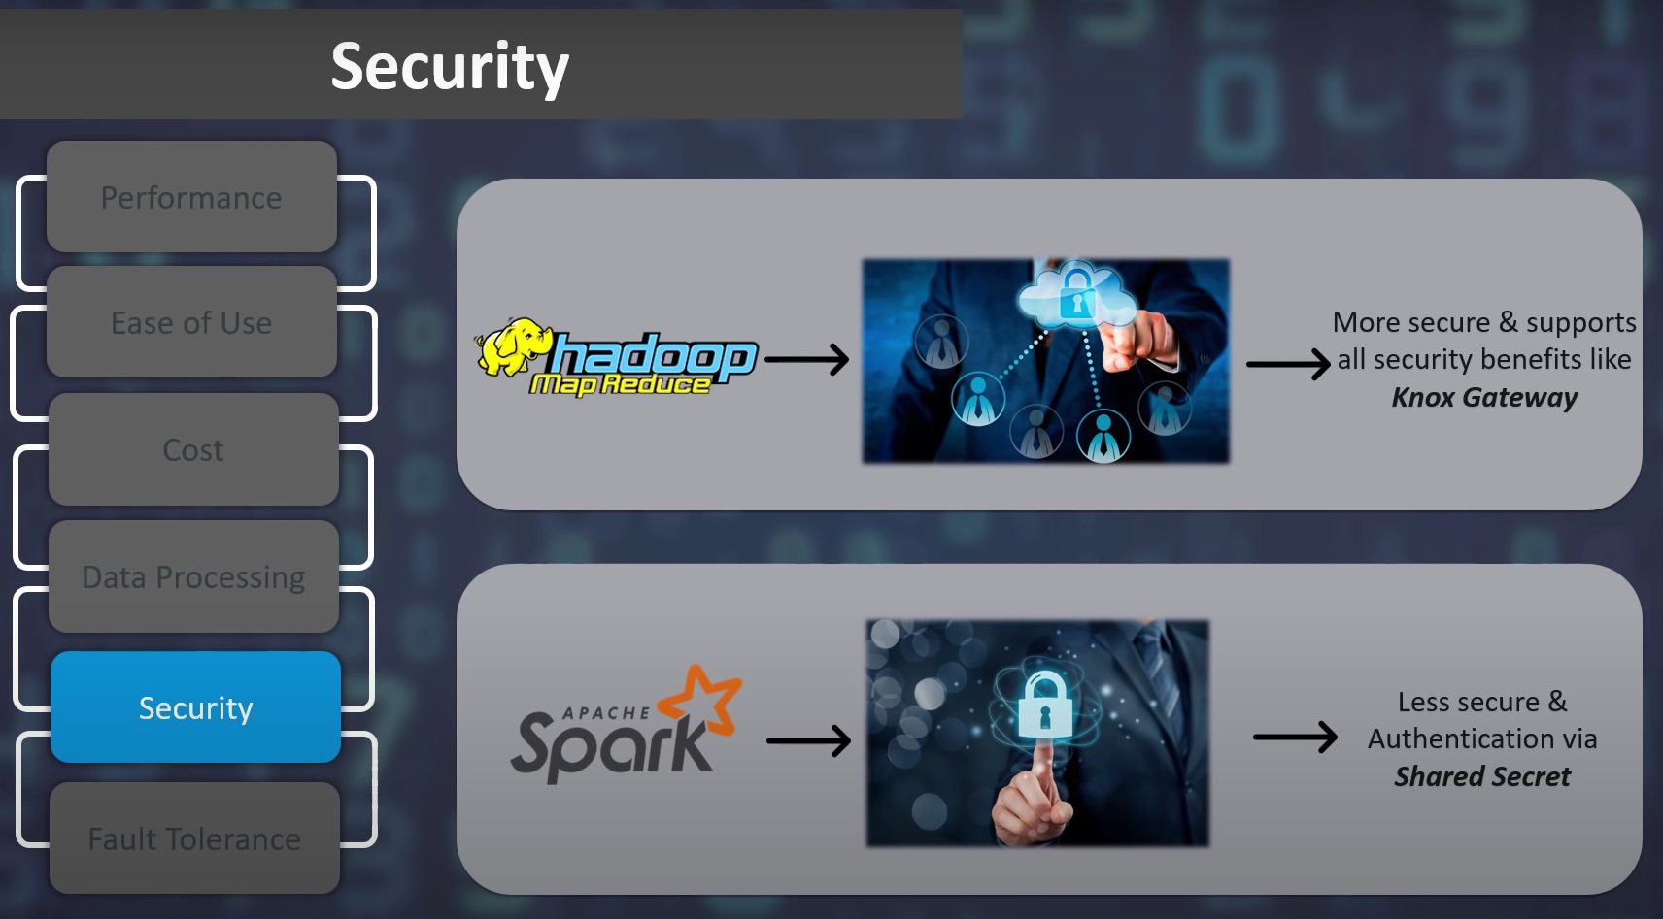

Slide 9
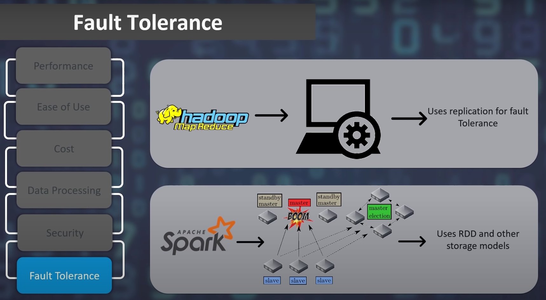

Slide 10
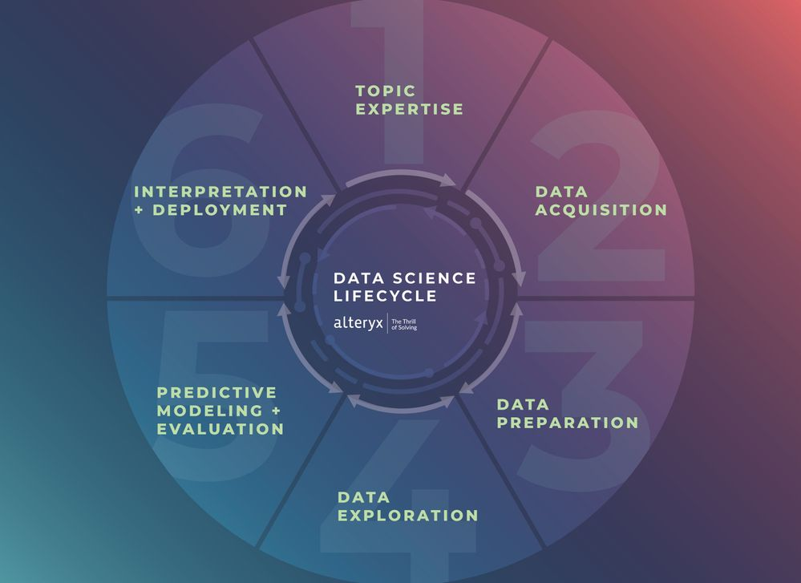

Slide 11
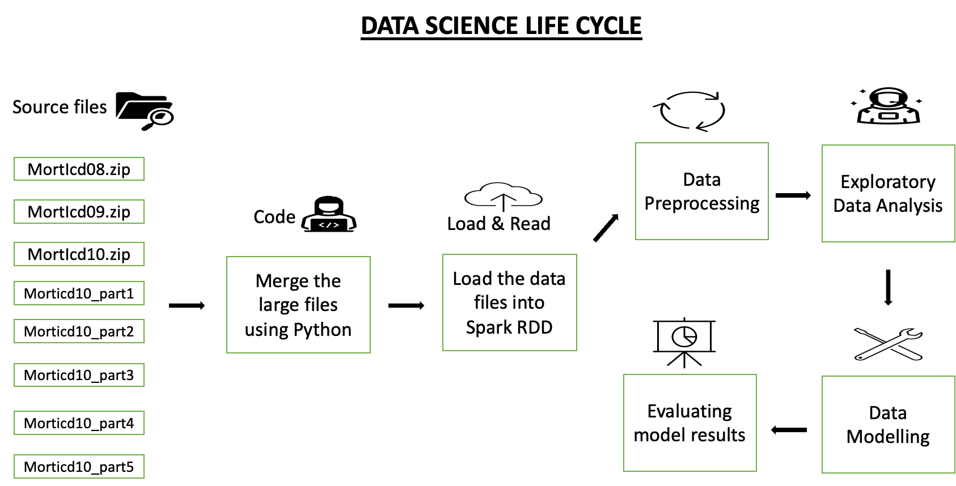

Slide 12
Data Gathering
WHO's official website
https://www.who.int/data/data-collection-tools/who-mortality-database
Data Statistics
Combined different files
Binning of data according to the age

Slide 13
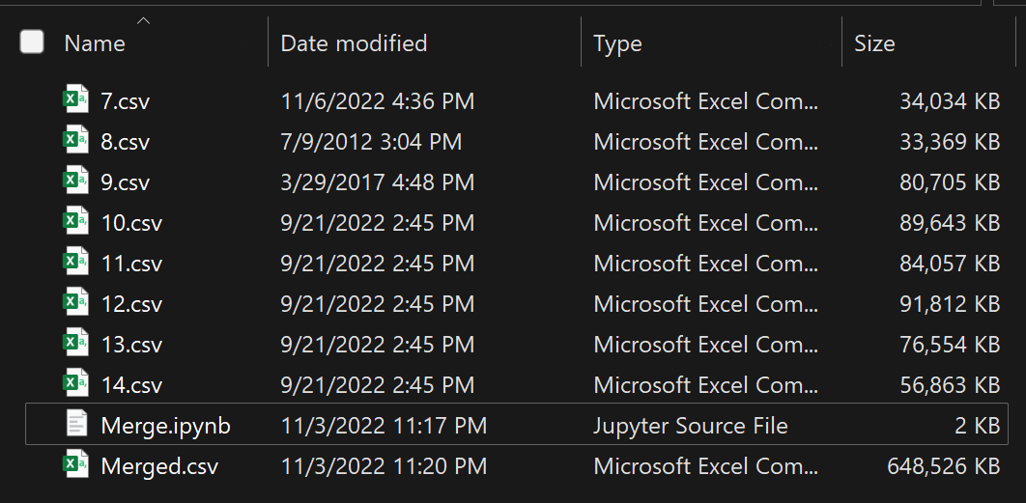
Data Preparation

Slide 14
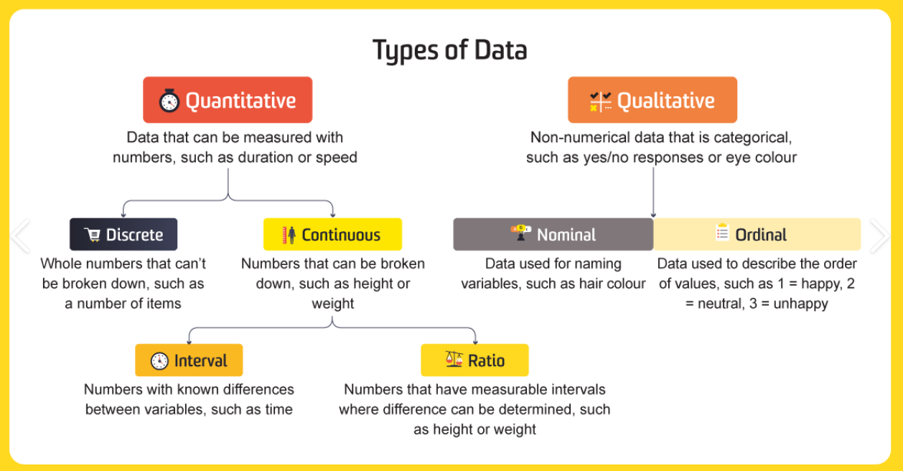
About the Data

Slide 15
Meta Data of Columns
Discrete | Continuous | Nominal | Ordinal
Country | Death1 ~ 26 | Sex | Admin1
Cause | IM_Deaths1 ~ 4 |  | SubDiv
 | Frmat |  | Year
 | IM_Frmat |  | List

Slide 16
Data Wrangling
How we are cleaning data
Data Preprocessing steps
Remove any null values
Remove any outliers
Remove records which have few attributes missing
Streamlining all the data and rounding to absolute value, such that all records follow the same format
Set a date and time format on columns, such that all records follow the same format
Sorting the data

Slide 17
Exploratory Data Analysis
Showing the max deaths top 10 deaths by country
Bar Chart : 1955 to 2022 How the deaths year wise in USA
Infant death vs overall deaths
Top 10 diseases reasons died in USA
Obesity from 1955 to 2022
Accidents deaths from 1955 to 2022

Slide 18
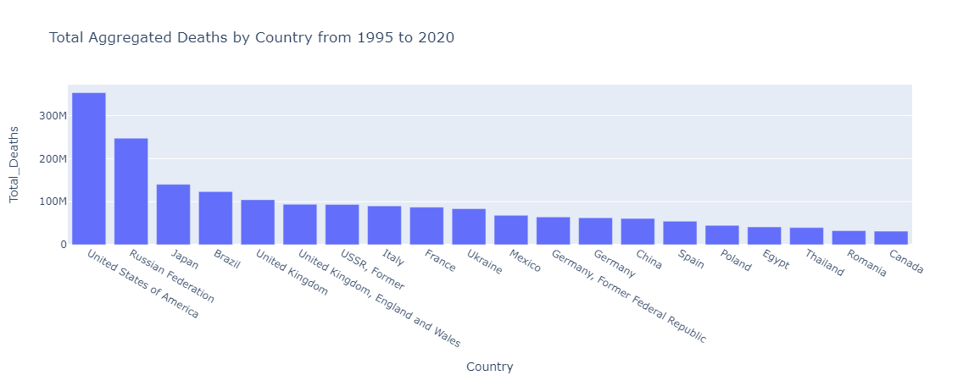
Visualizations

Slide 19
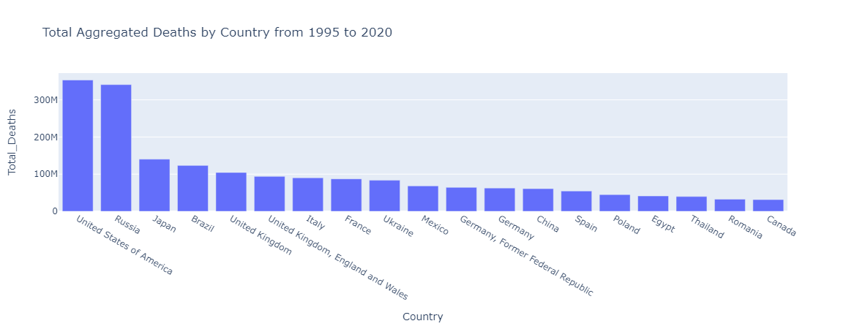
Russian Federation, USSR Former

Slide 20
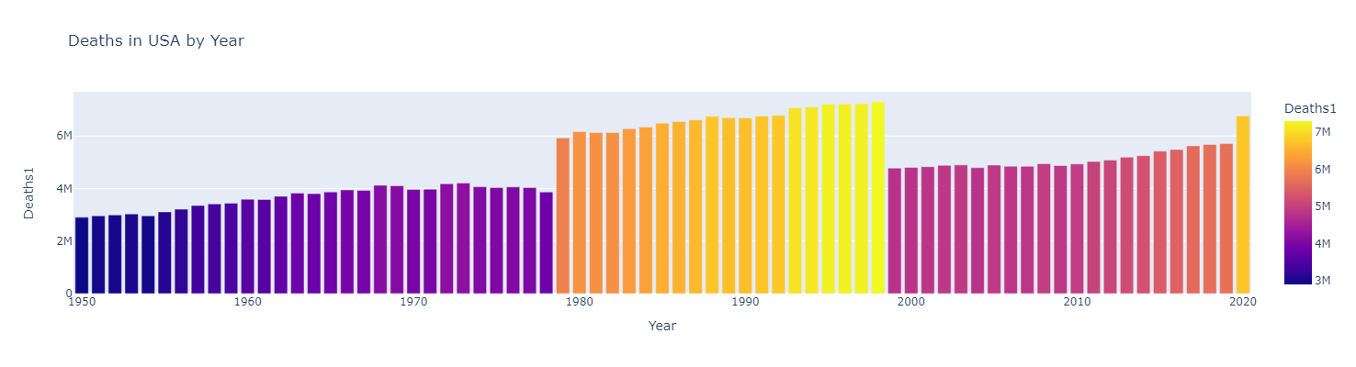
Deaths in USA by Year

Slide 21
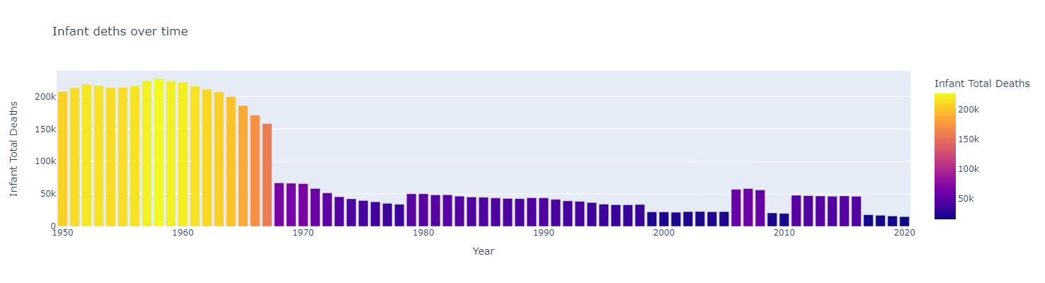
Infant deaths over time

Slide 22
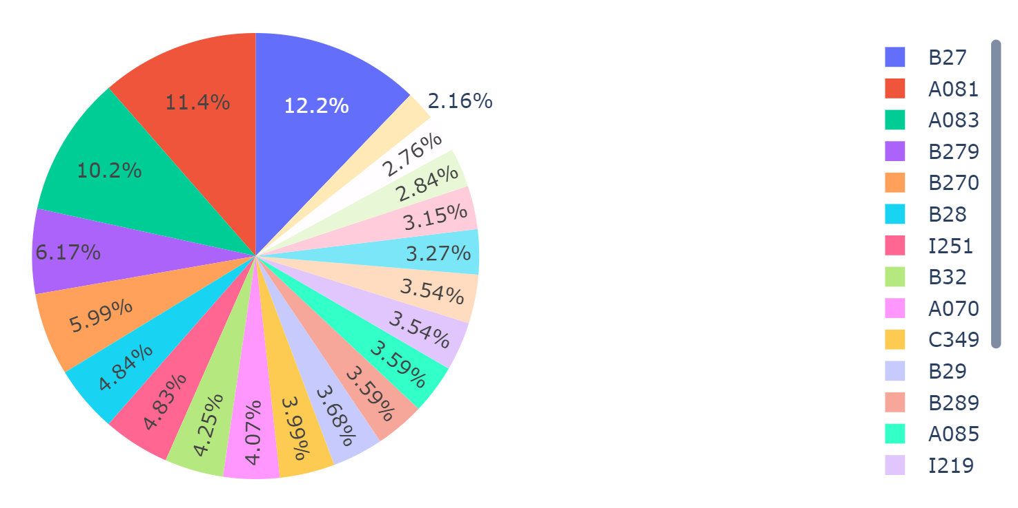
Causes of Deaths

Slide 23
Conclusion
Bringing several unaddressed issues into limelight to gain the attention of authorities
Society gets benefitted in a big way
Awareness is spread among the people
Introduction of health schemes
Raising funds to offer
Identification of unknown diseases that could trigger a pandemic

Slide 24
What we learnt from this project
What is Apache Spark
What are RDD’s
How Spark process data
Loading Data into Spark RDD datframes
Data Transformation
Filtering, binding, merging, collecting, Cleaning
Advanced Data Visualization Library

Slide 25
References

Slide 26

Questions

Slide 27
References
https://www.youtube.com/watch?v=F8pyaR4uQ2g&ab_channel=edureka%21
https://spark.apache.org/docs/latest/
https://hadoop.apache.org/docs/current/

